Slide 1
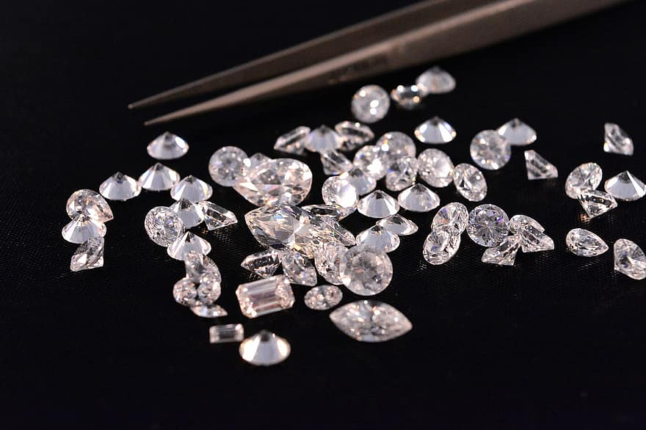
Diamond Price Prediction
Mayura Solow
Dan Watson
KaBria Broadwater
Nico Eiden

Slide 3
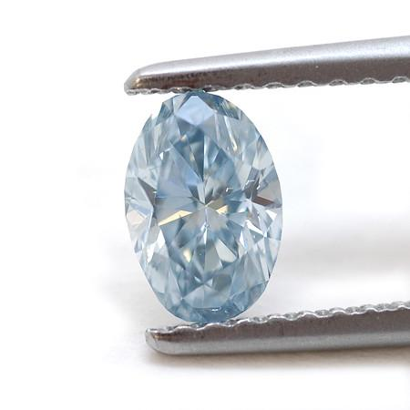
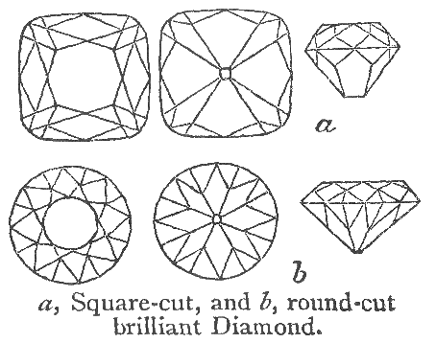
3 C’s “Clarity, Cut & Color”
Clarity:
Cut:
Color:

